Slide 1
Power Virtual Agents in Microsoft Teams
Module 4
Notes:
Workshop Version: 1.4

Slide 2

Module overview
This module covers the following topics:
 | 1 | Overview of Power Virtual Agents in Microsoft Teams
 | 2 | Power Virtual Agents building basics
 | 3 | Chatbot lifecycle
 | 4 | Best practices
 | 5 | Hands-on lab: Build a chatbot

Slide 3

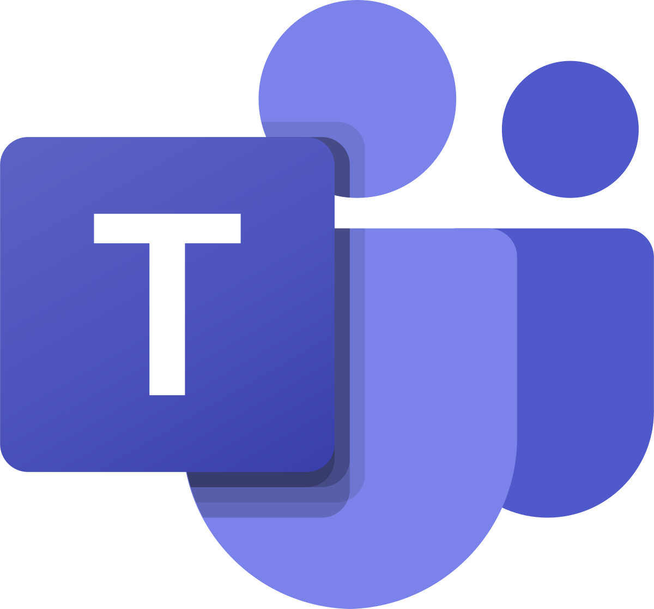




Overview of Power Virtual Agents app in Teams
Power Virtual Agents is a low-code / no-code, guided graphical interface that allows easy creation of chatbots by users of Microsoft Teams
Chatbots in Teams to help employees with common issues and answer common questions
Chatbots in Teams are transforming how organizations engage with their employees
Microsoft Confidential
Notes:
Build personalized bots allow employees to look up information with transparent Teams identity and authentication.
Increasingly, organizations are using bots in Teams to help employees with common issues. Chatbots help employees with common issues and answer questions posed by team members or other users, all within the Microsoft Teams client interface
Since Teams is inherently conversational, it’s natural and intuitive for Teams users to chat with these virtual representatives.
You can easily build intelligent bots for your employees
No-code, graphical chatbot building interface embedded right inside of Teams – – no coding or AI expertise needed.
Build personalized bots allow employees to look up information with transparent Teams identity and authentication.
Bots can quickly resolve common issues, and when they can’t help, they can easily contact live representatives in a Teams chat, open a ticket or take an action
Publish your chatbot to all your employees or to the Team of your choice with a single click
Tailored chatbots to manage requests and share information
Chatbots are transforming how organizations engage with their employees, organization noticed surge in virtual communication and conversations between businesses and their employees.

Slide 4
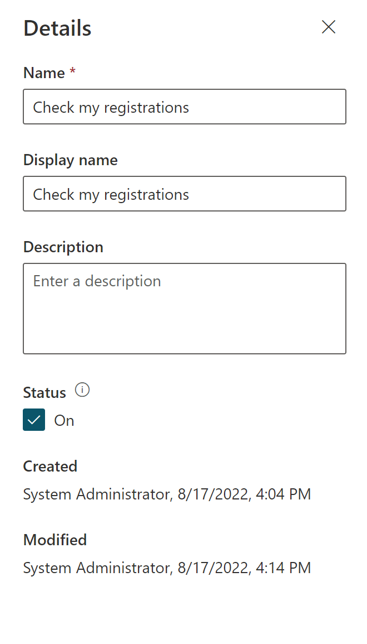
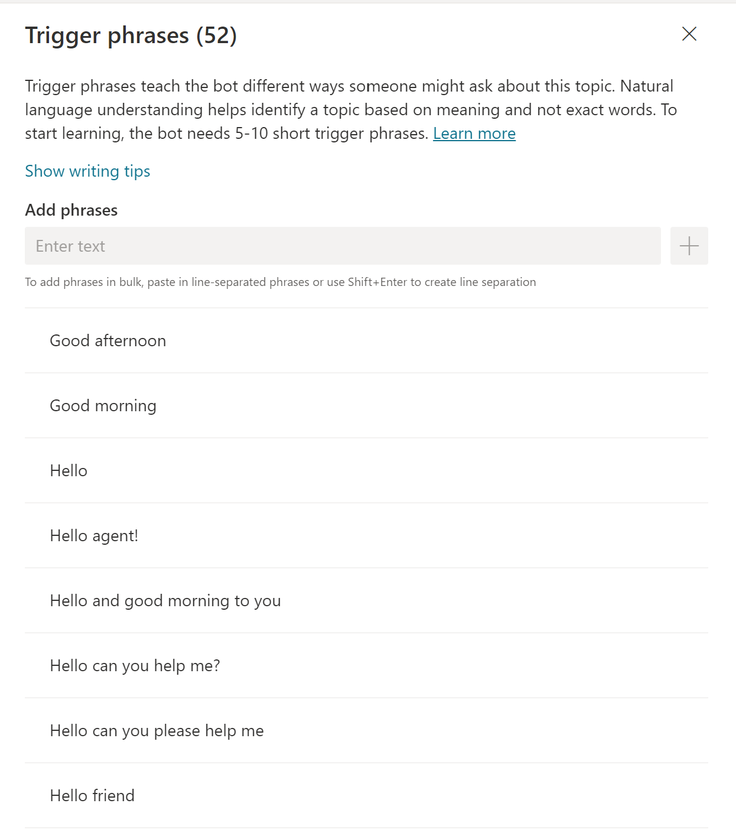
Power Virtual Agents – Topics
Topics determine dialogs supported by chatbot
Chatbot can be redirected to topic by:
Trigger phrases
Redirect from another topic
Notes:
Demo to attendees PVA topics using demo tenant not slides.

Slide 5
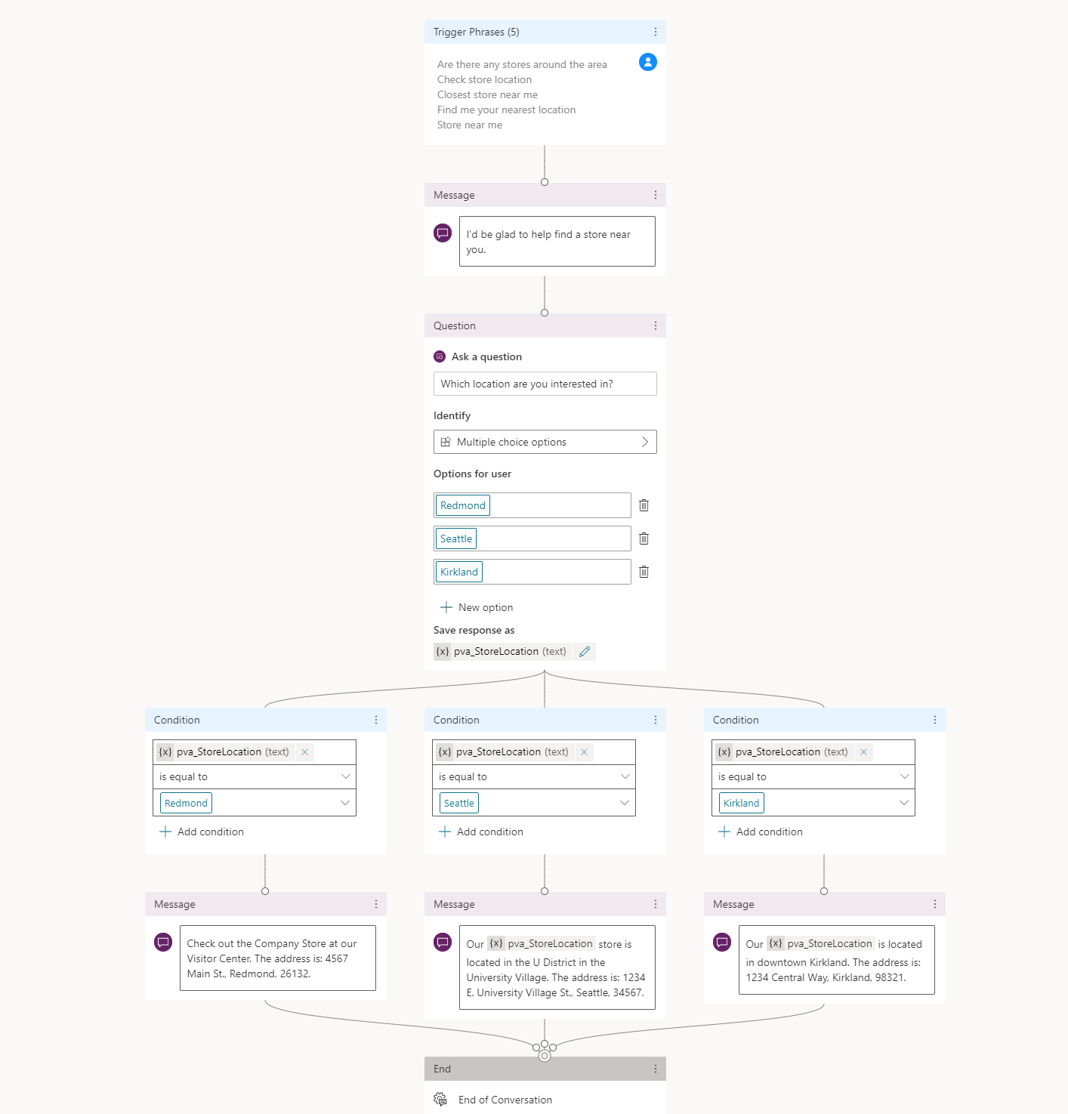
Power Virtual Agents – Authoring canvas
Authoring canvas is used to define a dialog flow
Authoring Canvas nodes:
Question
Condition
Call an action
Message
Switch Topic
End Conversation
Notes:
Demo to attendees PVA authoring canvas using demo tenant not slides.
Explain, the Authoring Canvas is the place where you can design the flow you would like your chatbot to execute when a certain topic gets triggered.

Slide 6
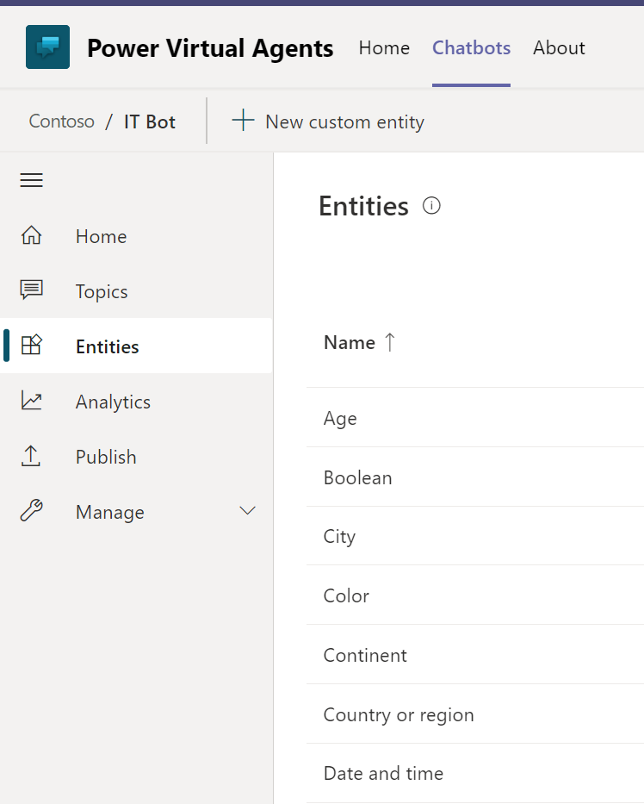
Power Virtual Agents – Entities
An entity can be thought of as a unit of information that represents a certain type of a real-world subject, like a phone number, city, etc
Entities help the bot recognize the relevant information from a user input and save it for later use
Notes:
Demo to attendees PVA Entities using demo tenant not slides.
Example, ask and echo back the date entity – show how PVA parses the date
Explain, one fundamental aspect of natural language understanding (which is the ability for chatbots to understand a person's natural way of talking) is to identify entities in a user dialog.
There are prebuilt entities (datetime, number, age, money, colors, person names).
Create and use entities in Microsoft Teams - Power Virtual Agents | Microsoft Docs

Slide 7
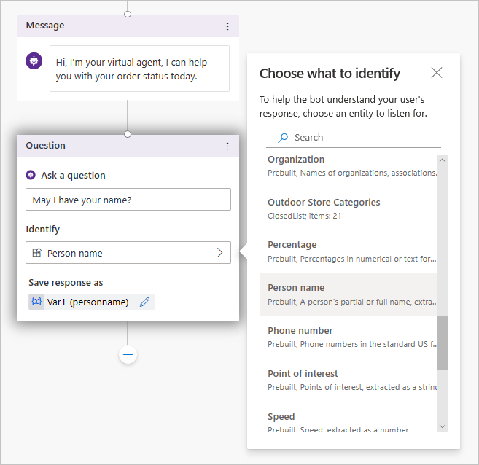
Power Virtual Agents - Variables
Variables - save responses from users in a conversation with your bot, so that you can reuse them later
Variables can be used to dynamically determine the conversation path
You can add and use variables in a bot's authoring interface in Microsoft Teams
Notes:
Demo to attendees PVA topics using demo tenant not slides.
Explain, you can add and use variables in a bot's authoring canvas in Microsoft Teams
“Variables” allow your bot to both gather user information and store it for later use
For example, you can save a customer's name in a variable called UserName. The bot can then address the customer by name as the conversation continues.

Slide 8




Lifecycle of a Power Virtual Agent chatbot
Create
Build
Teach
Create using a simple graphical interface
User starter topics to build upon
Author topics with variables, etc.
Improve
Configure
Monitor performance and improve
Configure topics details
Release
Extend
Publish to Microsoft Teams
Extend activities for more complex scenarios
Notes:
Improve step – switch to the next slide and explain, how Bot Analytics can help
Also, it can be beneficial to rely on best practices, when building a bot. Some of the best practices explained further and you may find some additional slides in Appendix.

Slide 9
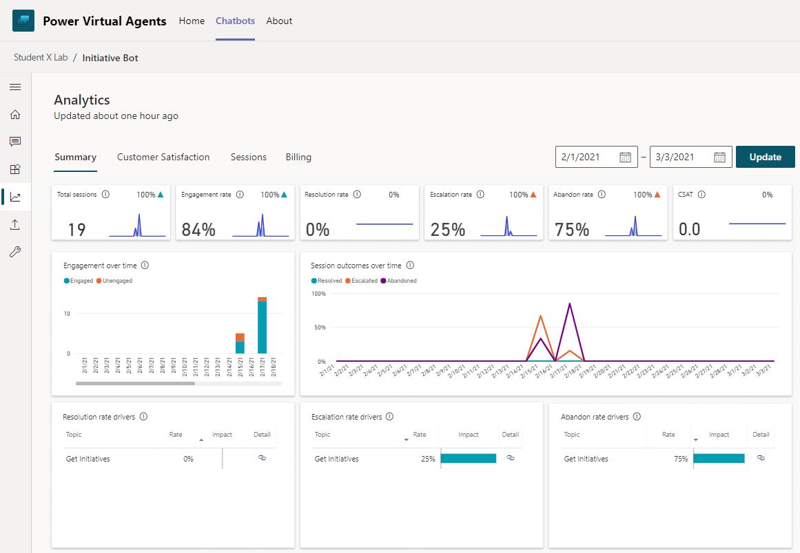
Power Virtual Agents – Analytics
Built-in analytics report can be used to monitor and improve the bot
It provides insights for:
Summary
Topic triggering
Customer Satisfaction
Sessions
Billing
Notes:
Power Virtual Agents has a comprehensive set of analytics that show you the key performance indicators for your bot.
Multiple charts show you trends and usage for your bot's topics. These charts use AI to highlight the topics that have the greatest impact on your bot's performance.
Sessions transcripts are unavailable for download on the Power Virtual Agents app in Teams. To review and export session information, you'll need to sign up for the Power Virtual Agents web app https://docs.microsoft.com/en-us/power-virtual-agents/requirements-licensing-subscriptions

Slide 10
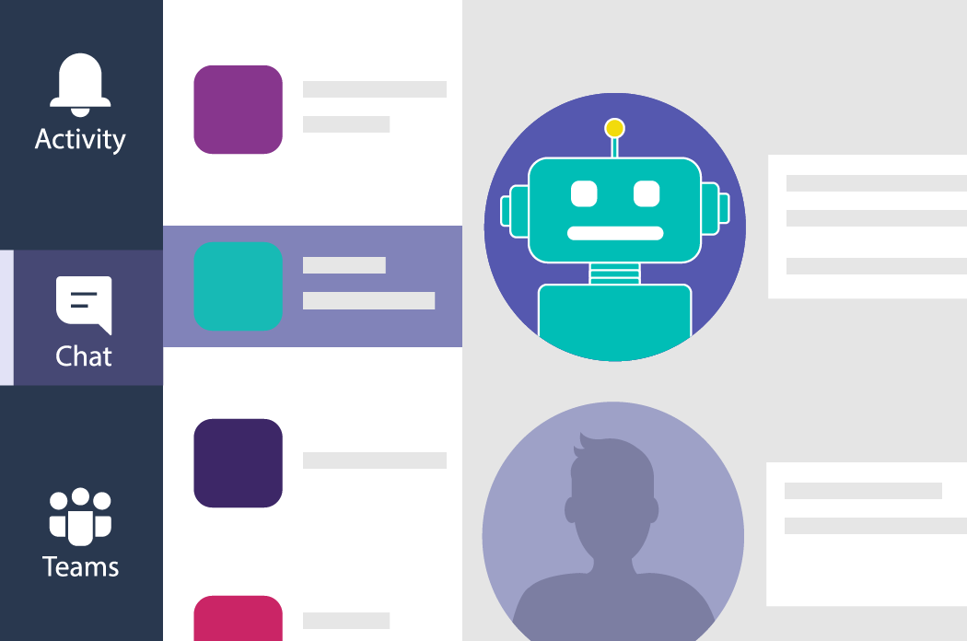
Best practices when planning chatbots
Align the bot with your organization’s goals
Identify the right requirements
Start small and scale up
Track analytics for ongoing improvements
Notes:
Impendence between SME subject matter expert who understand customer experience such as HR , customer service people and developers ( technology people) who create bots to design it together
Test your bot, and then make it available to your team or entire organization
Review and analyze the performance of the bot, such as what questions are being asked the most, and how effective the bot is at understanding and answering questions
Bots are useful if it has full integration with backend and provide personalized answers
Best practises when planning to use https://powervirtualagents.microsoft.com/en-us/blog/best-practices-when-planning-to-use-chat-bots/

Slide 11
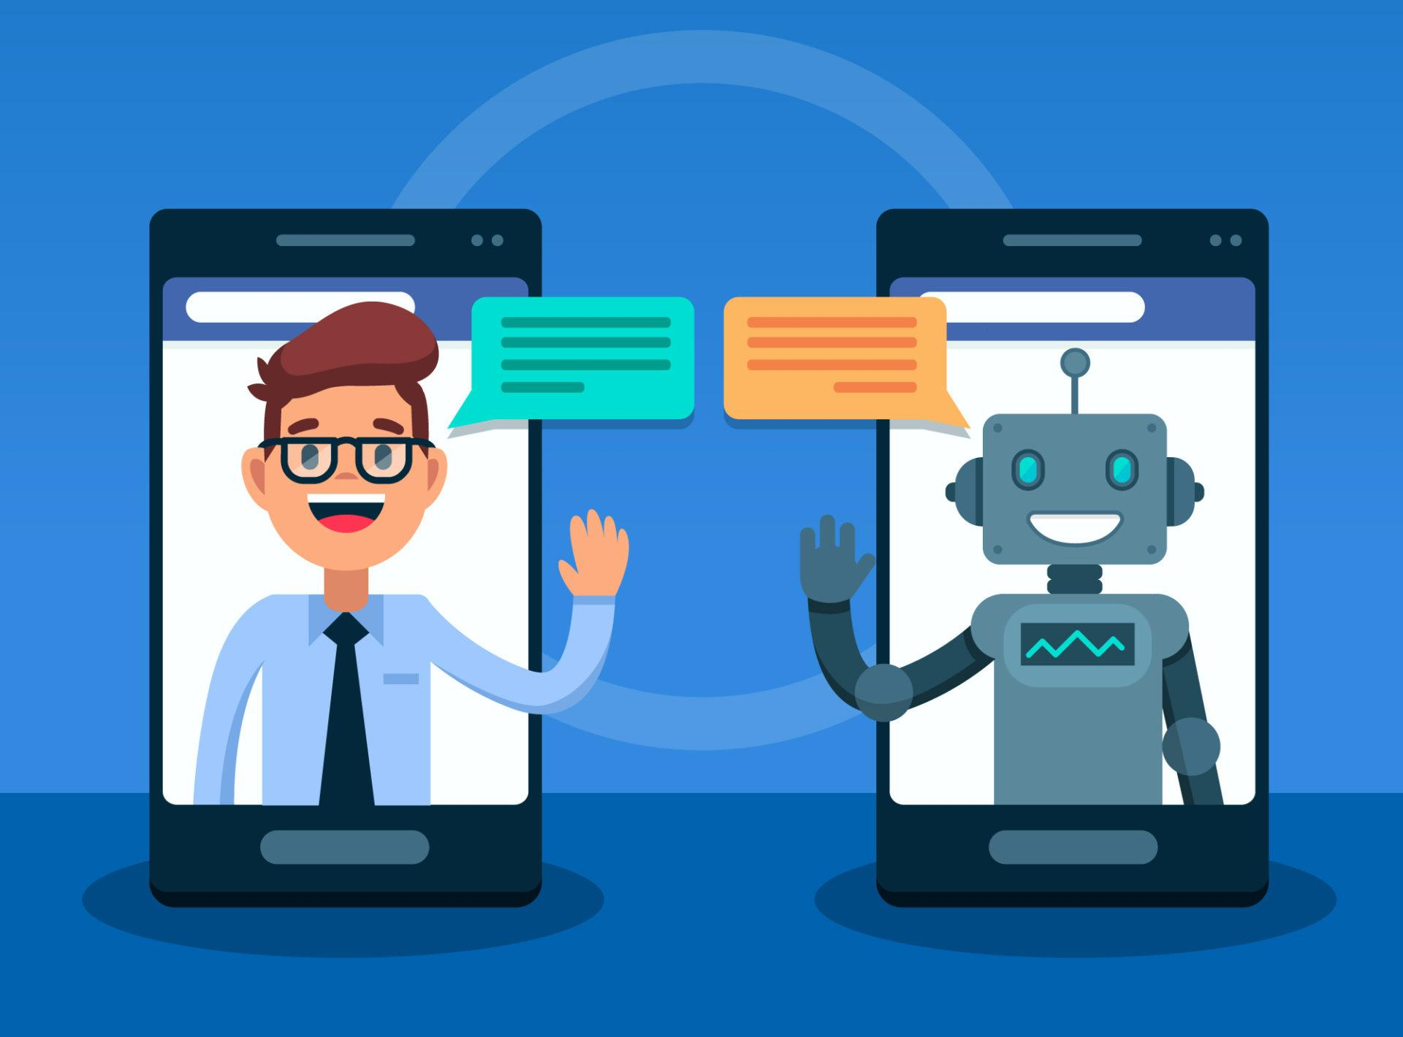
Best practices when building chatbots
Greet and set the expectations
Never ask open ended questions
Inform about long running tasks
Inform next steps
Handle interruptions
Review analytics periodically
Identify the right channels
If bot couldn’t help - hand off to the human agent
This Photo by Unknown Author is licensed under CC BY-SA
Notes:
If chat couldn’t answer any questions , there is a choice to Hand off to the human agent. Not best practice to use this option always.

Slide 12
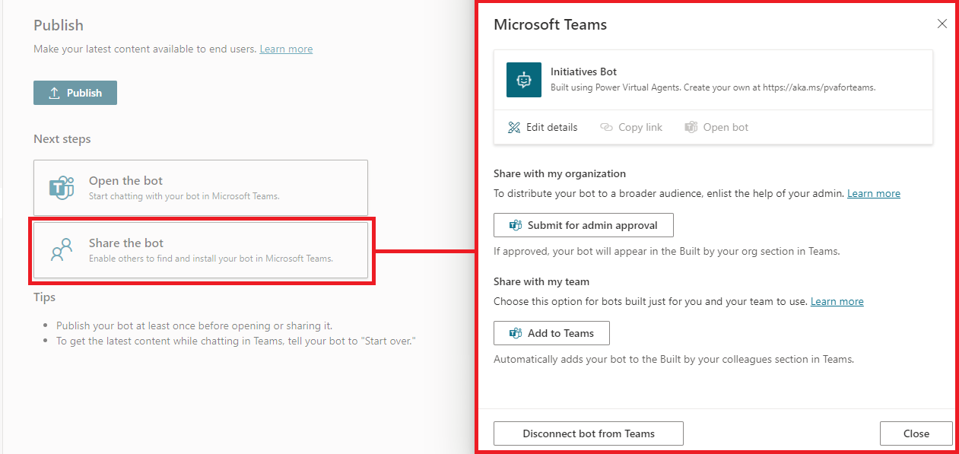
Share the bot with your team or your organization
You could choose to share with your bot with your organization, require admin approval
You could choose to share with your bot with your team to use
Notes:
Publish your chatbot with the Power Virtual Agents app in Microsoft Teams - Power Virtual Agents | Microsoft Docs
1- You can share the bot with your organization by submitting your bot for admin approval to be featured in the Built for your-organization-name > Built by your org section.
Once a bot is approved by an admin, the bot availability in the Built by your org section will be completely managed by your admin. Only an admin can remove the bot from the Built by your org section.
2- share with my team: Once you've published your bot, you can share it with other Microsoft Teams users so they can find it in the Microsoft Teams app store. You can share it with your team directly.

Slide 13

Lab 4: Build a chatbot
Objectives
Create flows that will implement chatbot actions
Build a chatbot using PVA app in Teams
Publish the chatbot to Teams
Never upload your organization data to the lab tenant.
Notes:
In the lab you will build a chatbot
##########

Slide 14
Appendix

Slide 15




Best practices: Greet and Set the Expectations
Travel Bot
02/01/21 1:37 PM
Travel bot
02/01/21 1:37 PM
Hey, I m a Bot.
Hey, I m an Airline Bot. I can help you with Check-in or take any questions about your itinerary.
02/01/21 1:38 PM
That’s right, but what can you do for me?
Notes:
Best practices when planning to use chat bots | Microsoft Power Virtual Agents
Let the customer know about the skills that the bot supports so that the customer has a right expectation.

Slide 16
Best practices: Never ask open ended questions
Travel Bot
02/01/21 1:37 PM
Travel bot
02/01/21 1:37 PM
Which travel document do you choose to provide?
Which travel document do you choose to provide?
Passport
Driving license
02/01/21 1:38 PM
What do you mean by travel document? I have my visa. Is that what you want?
Notes:
In case, providing options is not ideal for the type of questions, try to provide some sample answers. If sample answers aren’t possible, ask a very closed question to strictly narrow the question so that the user doesn’t have a choice but to answer it directly.
Best practices when planning to use chat bots | Microsoft Power Virtual Agents

Slide 17

Best practices: Inform about long running tasks
Travel Bot
02/01/21 1:37 PM
Travel bot
02/01/21 1:37 PM
So, you want to purchase a check-in baggage allowance. Please give me your credit card details.
So, you want to purchase a check-in baggage allowance. Please give me your credit card details
02/01/21 1:38 PM
02/01/21 1:38 PM
Here is my credit card details.
Here is my credit card details.
After some time of inactivity
Travel bot
02/01/21 1:40 PM
02/01/21 1:40 PM
I am submitting your order. Please allow a few seconds and I’ll be with you
Hey Bot, are you there?
02/01/21 1:41 PM
???!!! BOT ???!!!
Notes:
If you as a bot maker sense that the bot is going to take a while to answer a particular question, your bot must let the customer know that there is going to be a few seconds delay to get the answer
It is essential at this point to let the customer know that “I am going to complete your payment, please allow me a few seconds and I’ll get back to you shortly with an update”.

Slide 18
Best practices: Hand off to the human agent
Travel bot
02/01/21 1:37 PM
Alright,Submitted your order. Bye!
02/01/21 1:38 PM
I just noticed that my passport is about to expire. Do you think I’ll have a problem travelling?
Travel bot
02/01/21 1:40 PM
Sorry, I can’t help you with that. Let me transfer you to a human agent. Please hold.
Notes:
Possible scenarios could be:
The bot understands the question, but do not know the answer.
The bot does not even understand the question.
The customer is beginning to get frustrated.
Possible errors from the Power Automate or the backend processes.

Slide 19
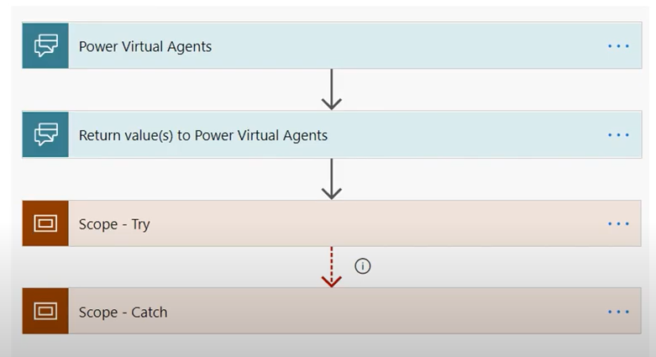
Best practices: Don’t block caller
When possible, return control back to PVA and process additional flow actions after return value action

Slide 20
Questions?

